Slide 1
Going the (MENTAL) Distance
Ashley Zapata, PsyD

Slide 2
My Background
Alliant Int’l University
PsyD/MA Clinical Psychology
Division I Athletics
University of Minnesota
Cornell University
George Washington University
University of San Diego
NBA/WNBA
Timberwolves and Lynx
Premier Sport Psychology (MN)
Sport Psychology
Individual sessions and team workshops/presentations (V/IP)
Adolescent to adult, all sports, nationwide

Slide 3
Agenda
Mental Toughness
Tools/Techniques
Questions

Slide 4
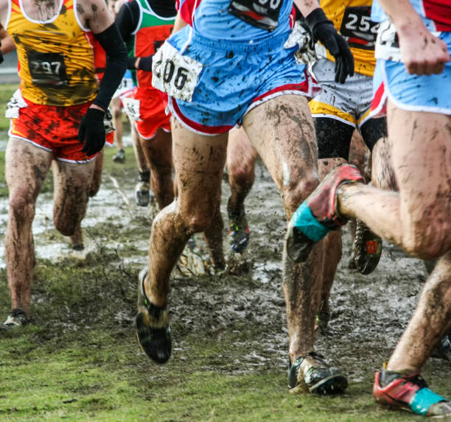
Difficulties/Struggles/Challenges
Physical Pain
Mental Fatigue
Time to Overthink
Self-doubt
Comparison
Pace
Boredom/Lack of Focus
Rollercoaster of Emotions
Extreme Confidence to Extreme Despair
Uncontrollable Conditions (weather)

Slide 5
What does being “mentally tough” mean to you?
Volunteers Welcomed!

Slide 6
-Mental Toughness-
The ability to cope with or handle pressure, stress, and adversity; an ability to overcome or rebound from failures; an ability to persist or a refusal to quit; insensitivity or resilience; and the possession of superior mental skills
Goal: feeling relaxed, calm and energized

Slide 7
Mental Toughness Tools & Techniques
Pre-Performance
(Goals + Imagery)
In The Moment
(Self-Talk + Focus)
Post-Performance
(3-2-1 Reflection + APE Score)
Take Notes!

Slide 8
Pre-Performance

Slide 9
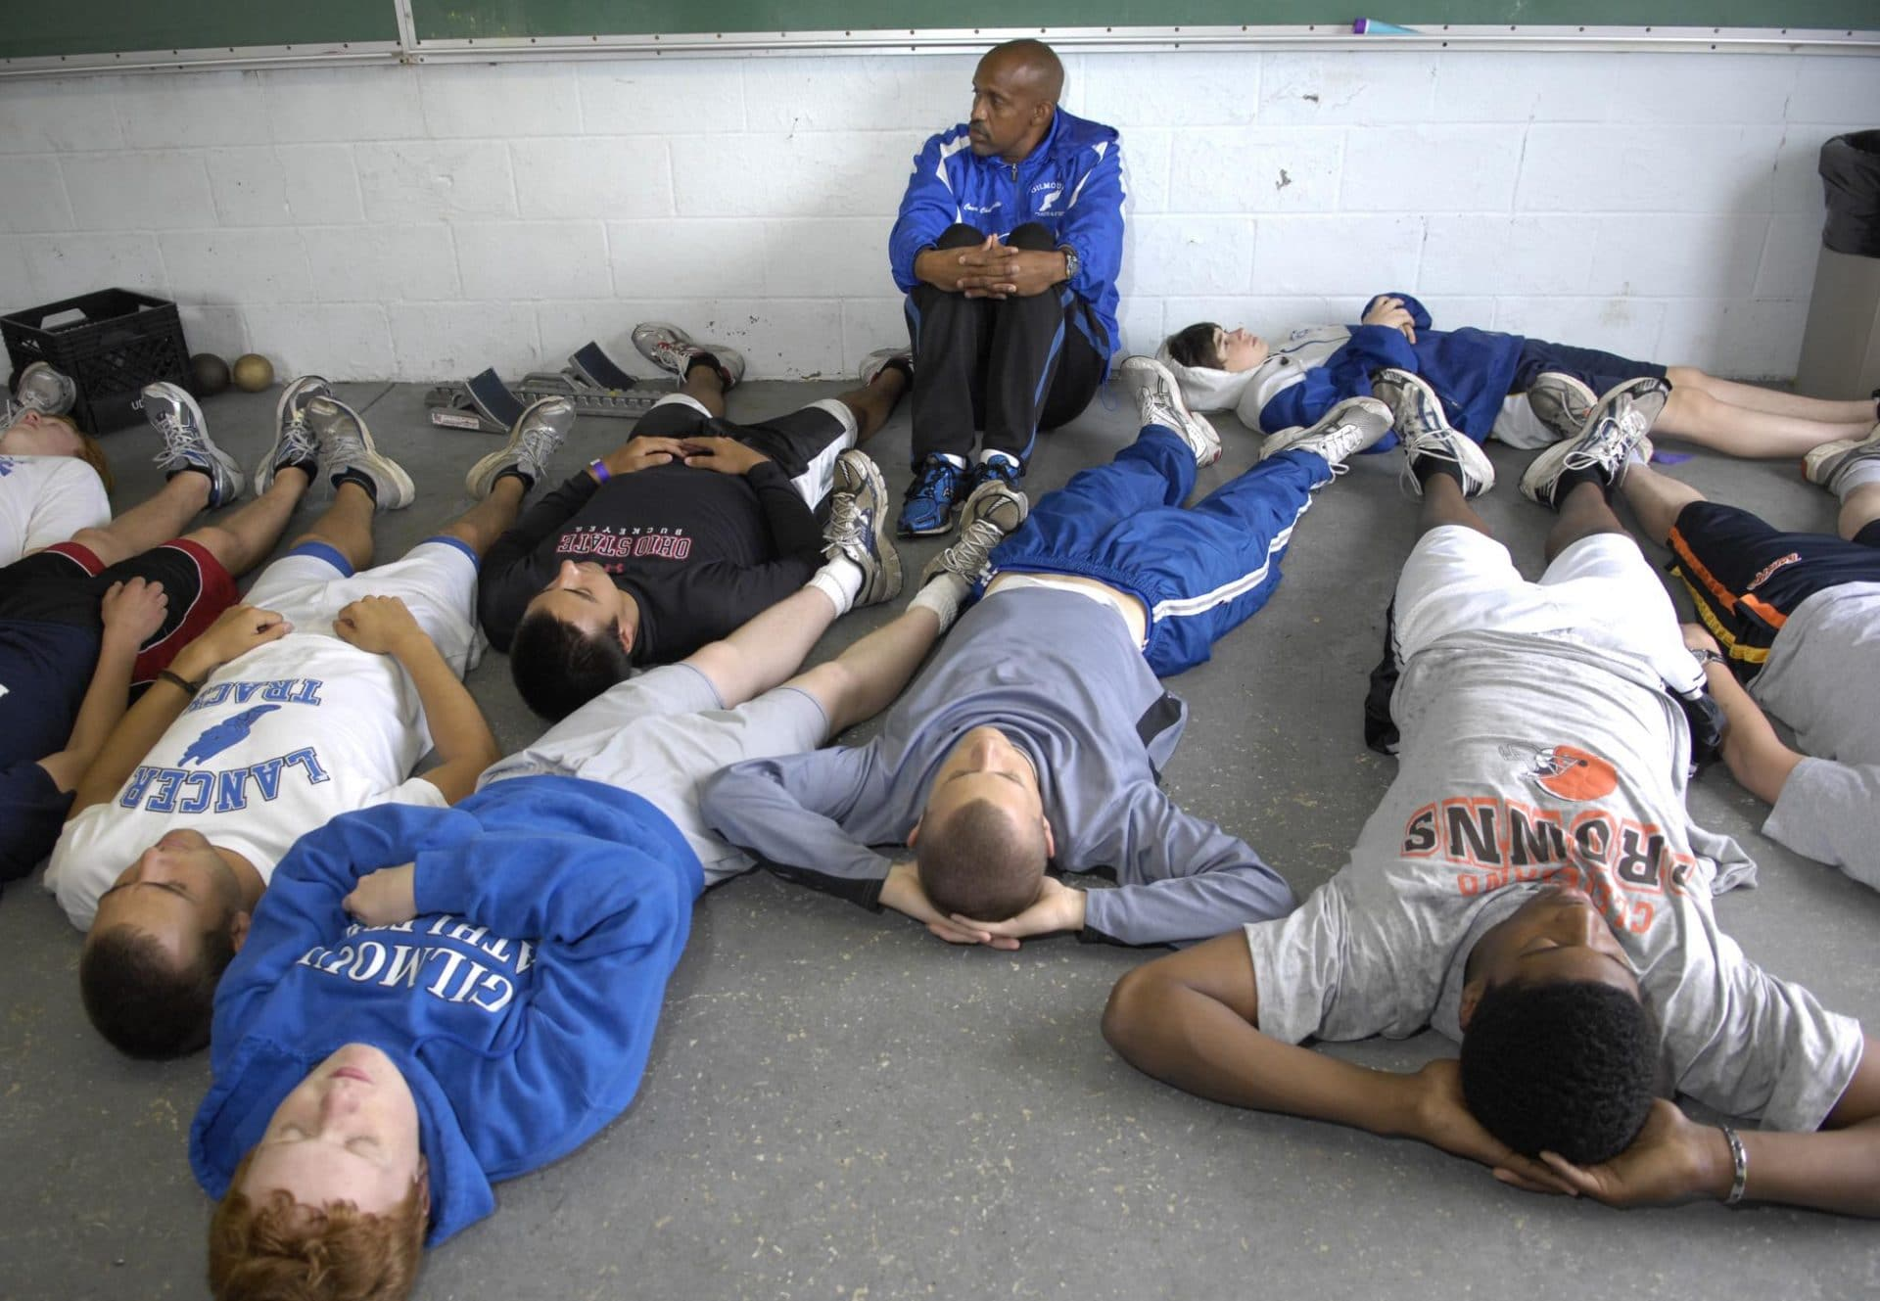
Pre-Performance Setting yourself up for success
S.M.A.R.T
Goals
Imagery
Notes:
Explain a little bit about each

Slide 10
S.M.A.R.T. Goal Setting
Specific
Helps to create a clear vision
Measurable
Helps to track progress
Adaptable
Allows change if needed
Realistic
Puts things in perspective, what are you capable of?
Time Based
Setting deadlines helps hold you accountable
Benefits of Goal Setting
Helps improve an athlete’s motivation, commitment, and focus
Helps to identify personal strengths as well as areas of improvement

Slide 11
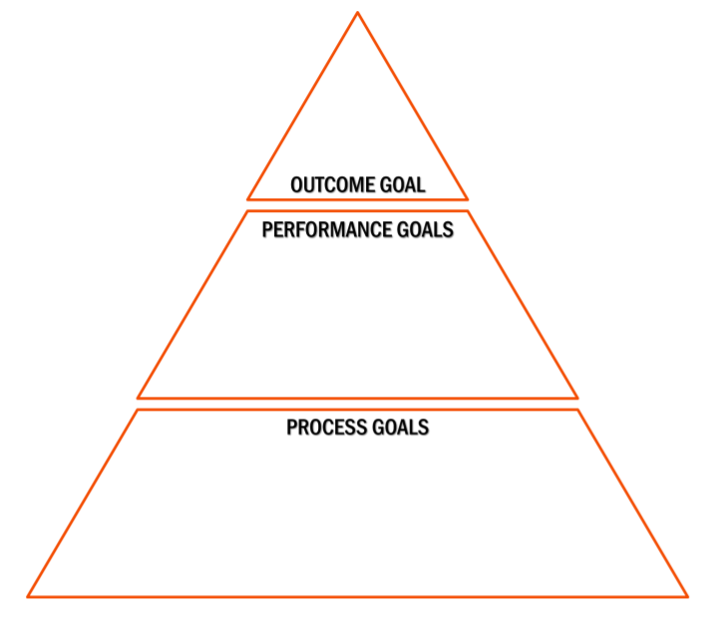
Overall result you
would like to achieve
Performance levels that
you need to achieve to
reach the outcome
Steps to take in
order to reach your
performance goals

Slide 12
1
Finish top 20
by final race
3
Pace/Weekly Mileage Goal
Staying healthy physically
Increase focus ITM
6
Complete daily training log
Include 2 weight training workouts/week
Get 8 hours of sleep each night
Cool down stretching post-runs
Engage in imagery 3x/week for 10 minutes
Write focus cue word on wrist before race

Slide 13
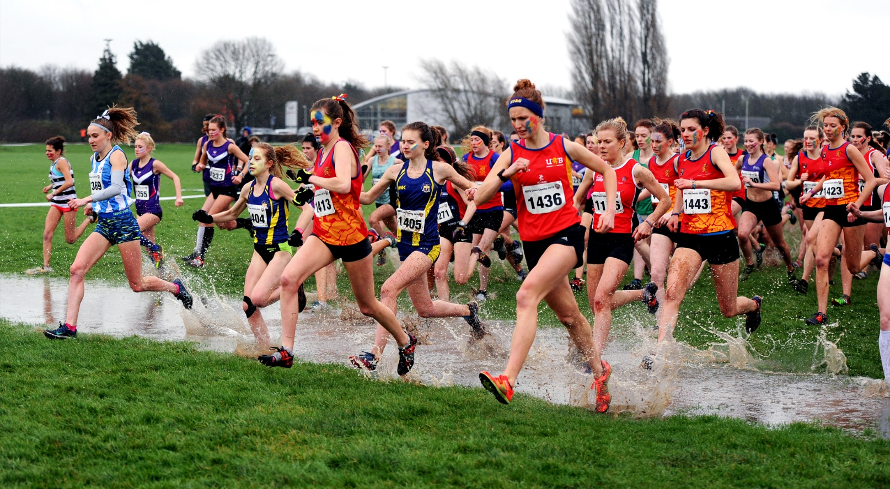
What is Imagery?
Imagery ≠ Visualization
Visualization is seeing performance in advance
Imagery is experiencing performance in advance
Imagery is the activation of the imagination to create or recreate a full sensory experience of a previous or upcoming event
Designed to enhance performance by rehearsing strategies, learning new skills, managing anxieties, building confidence, and optimizing activation levels
3-4 x/week, 5-10 minutes
Notes:
Discuss how the brain works with neural pathways

Slide 14
Vividness
The more detailed we can be about the experience, the more believable it is to our brain
Utilize all senses!

Slide 15
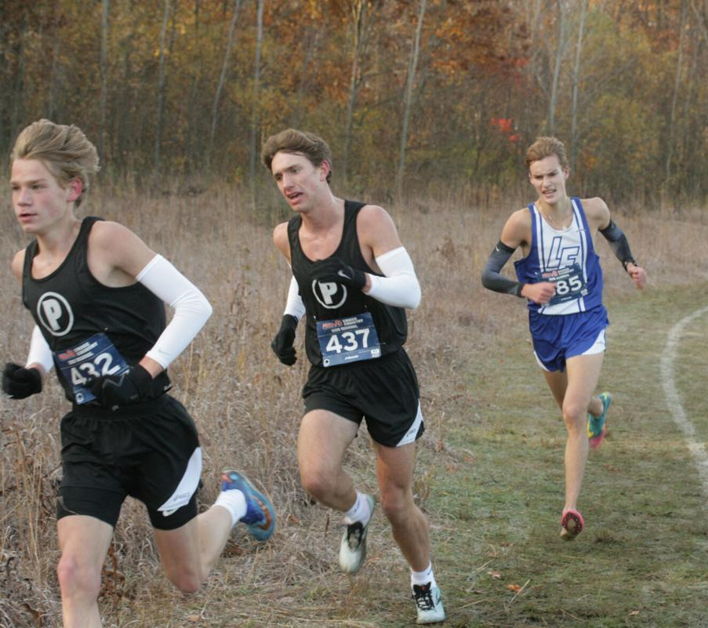
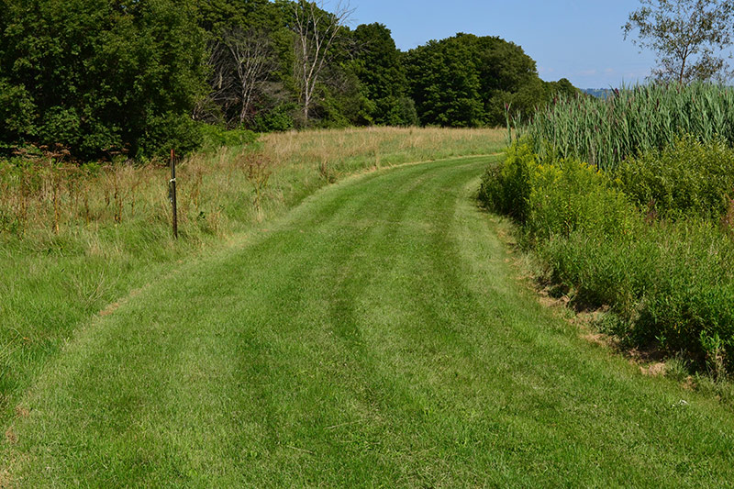
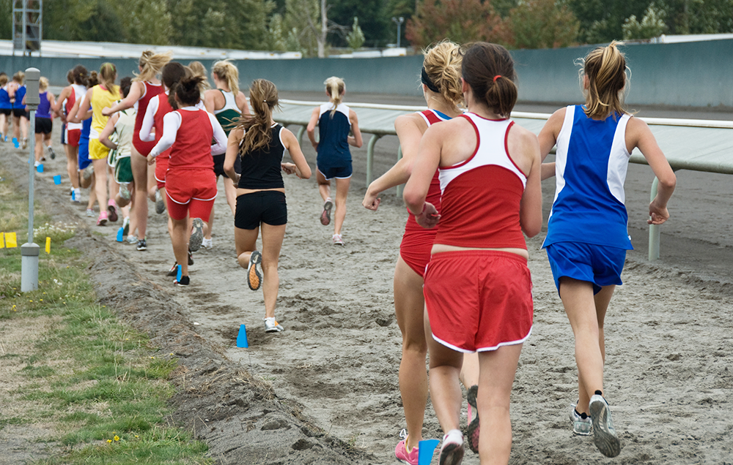
Controllability
Switch between in and out views to understand what works better for you
vs.

Slide 16
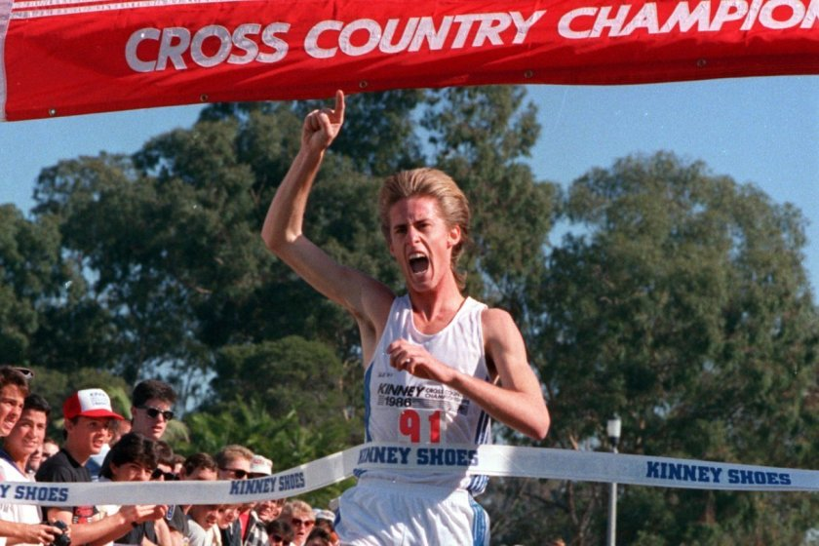
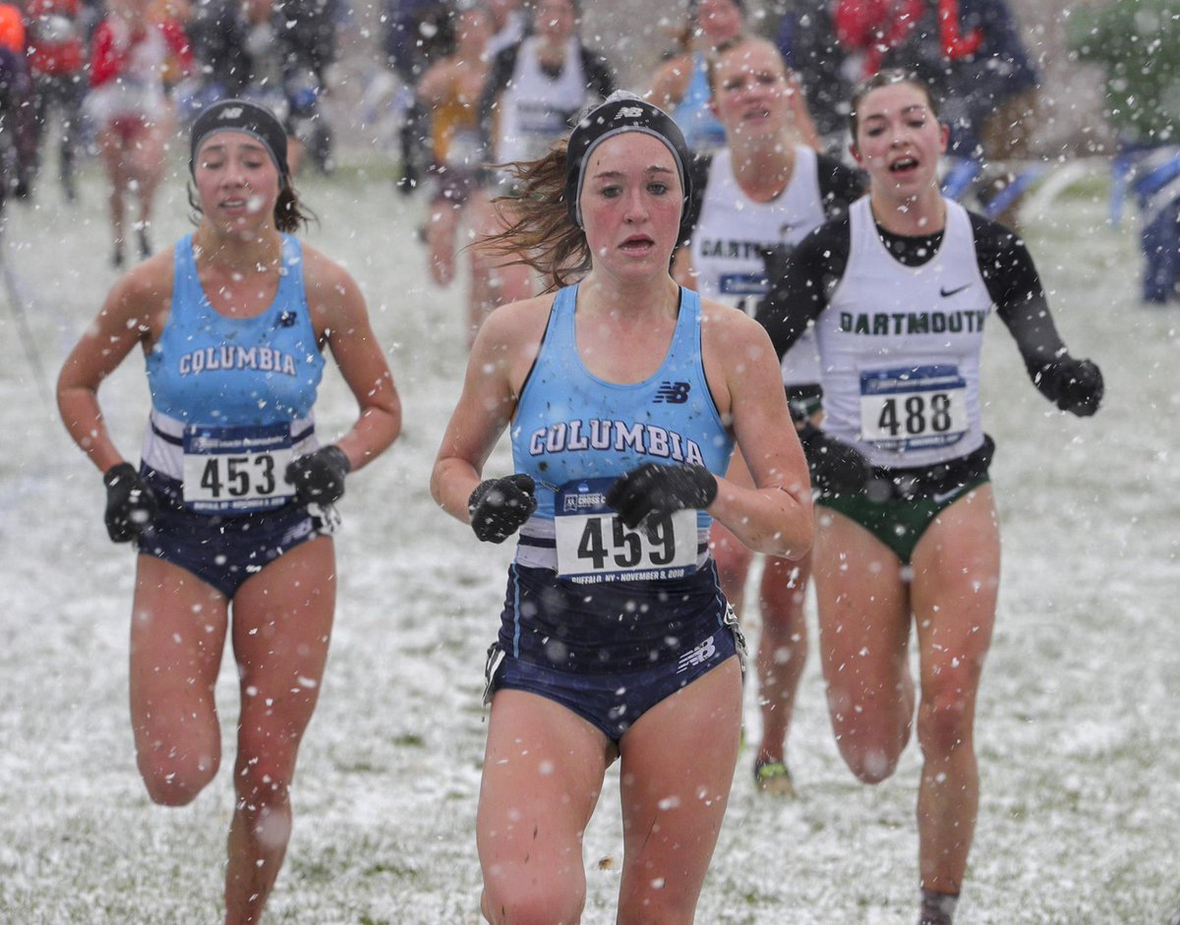
Command
Incorporate the (+/-) of performance you experience to help prepare you for challenges/difficulties you may face and command your performance ITM
&

Slide 17
Let’s Practice!
Close your eyes…
Vividness
Controllability
Command

Slide 18
In The Moment

Slide 19
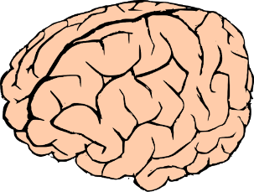
In The Moment Controlling the controllables
Productive
Self-Talk
Focus
Notes:
Explain a little bit about each

Slide 20
Focus
Notes:
Whatever you do, DO NOT think about this pink elephant. Set a timer and GO!

Slide 21
Performance Matrix Negative Focus

Slide 22
Performance Matrix Productive Focus
Stick to my race plan/pace.
I’ve trained for this moment all year. I know what I need to do.
Stay in my stride and be mindful of my breathing. Pass one person at a time.

Slide 23
Productive Self-Talk
When negative events or mistakes happen self-talk seeks to bring the positive out of the negative to help you do better, go further, or just keep moving forward.
What will you tell yourself…
When you feel intimidated?
When you’re nervous on the starting line?
When you feel pain?
When someone passes you?
When the weather is terrible?
What will you tell yourself…
Going into a race?
Preparing for a longer practice run?
When you pass someone?
When you’re feeling confident?
The last 100m of the race?
You believe what you tell yourself!

Slide 24
Types of Self-Talk
Encouraging/Motivational
I can do this
I have trained for this moment
I will finish top 20
Single word cues
Focus
Relax
Fearless
Instructional
Breathe
Slow down/pick up pace
Finish strong
Think It
Mouth It
Speak It

Slide 25
Post-Performance

Slide 26
Post-Performance Be your own hype-person
3-2-1 Reflection
APE Score
Notes:
Explain a little bit about each

Slide 27
3-2-1 Reflection Example
3 Things I Did Well Today
I stuck to my pace
I utilized productive self-talk during practice/race
I completed my rest & recovery
2 Things I learned Today
The last half of the race I start to lose focus
I don’t mind racing in the rain
1 Thing I want to improve on for tomorrow
Mindful breathing

Slide 28
APE Score
APE is an acronym to remind us what we can control with performance
A-your attitude and appearance (body language)
P-your preparation, presence and positivity
E-your effort, energy and emotions
At the end of each day grade yourself on these three components

Slide 29
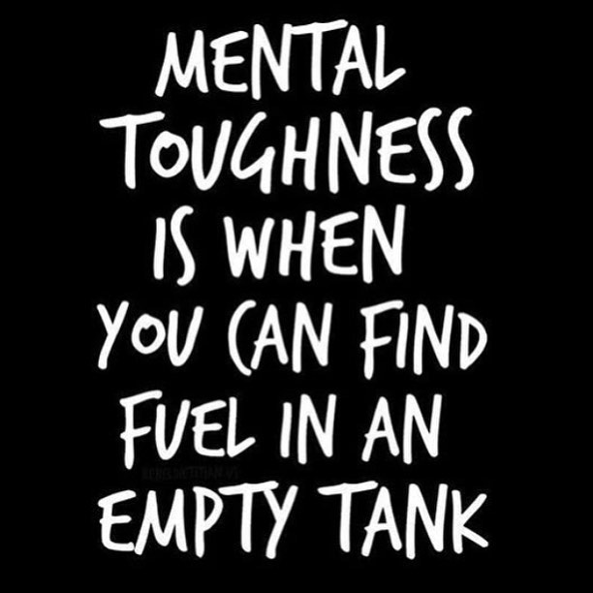

Slide 30
Questions?
Ashley Zapata, PsyD
azapata@premiersportpsychology.com

Slide 31
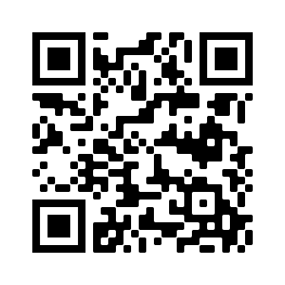
Anonymous Feedback Survey (1-2 min)
Premier Sport Psychology cares about the experience of our clients. Please help us monitor the quality of our presentations by answering some questions about your experience. We are interested in your honest opinions and we welcome your comments and suggestions as we grow and improve.
https://bit.ly/pspwebinarsurvey
Select the presenter (me: Ashley Zapata)
8 questions- rate your level of agreement with provided statements about the presentation (strongly disagree to strongly agree)
2 questions- free response, biggest takeaway & general feedback
Thank You!

